Slide 1
समाजशास्त्र: एक परिचय
INTRODUCTION TO SOCIOLOGY
INDUCTION PROGRAM
B.A.I,
DATE 01/09/2023

Slide 2
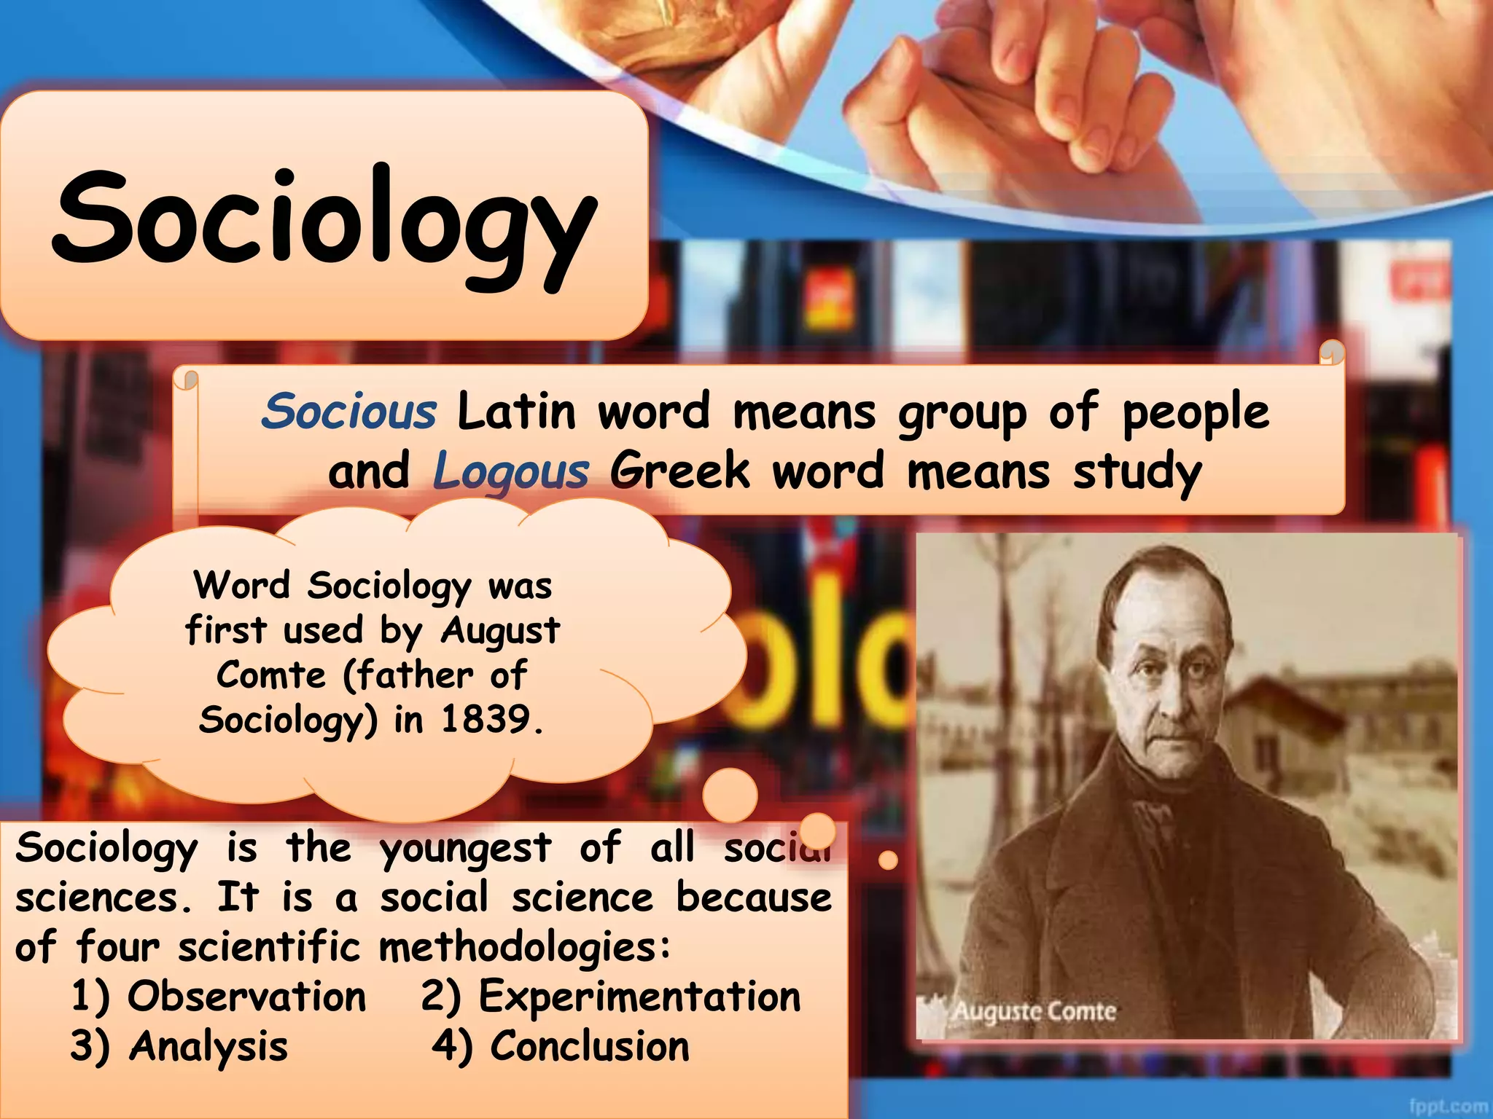

Slide 3
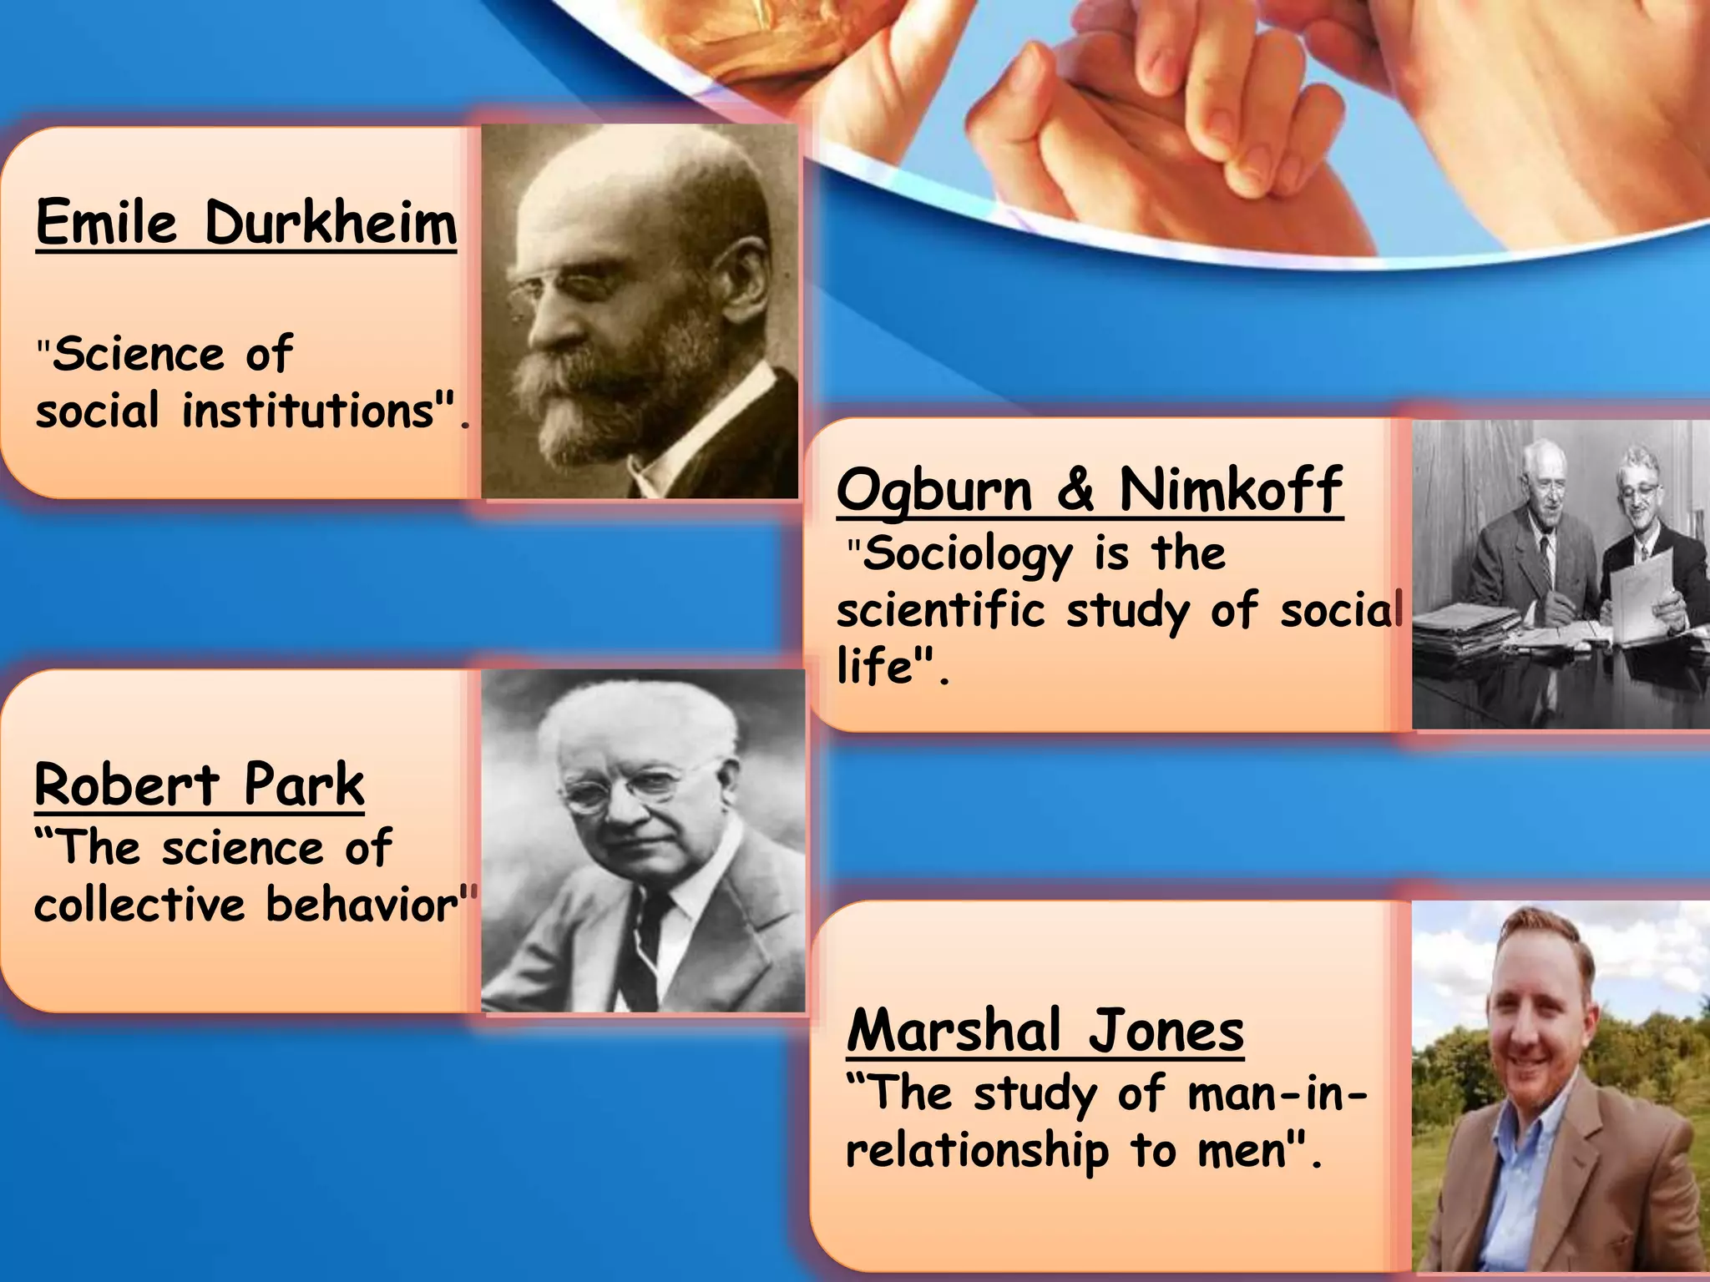

Slide 4
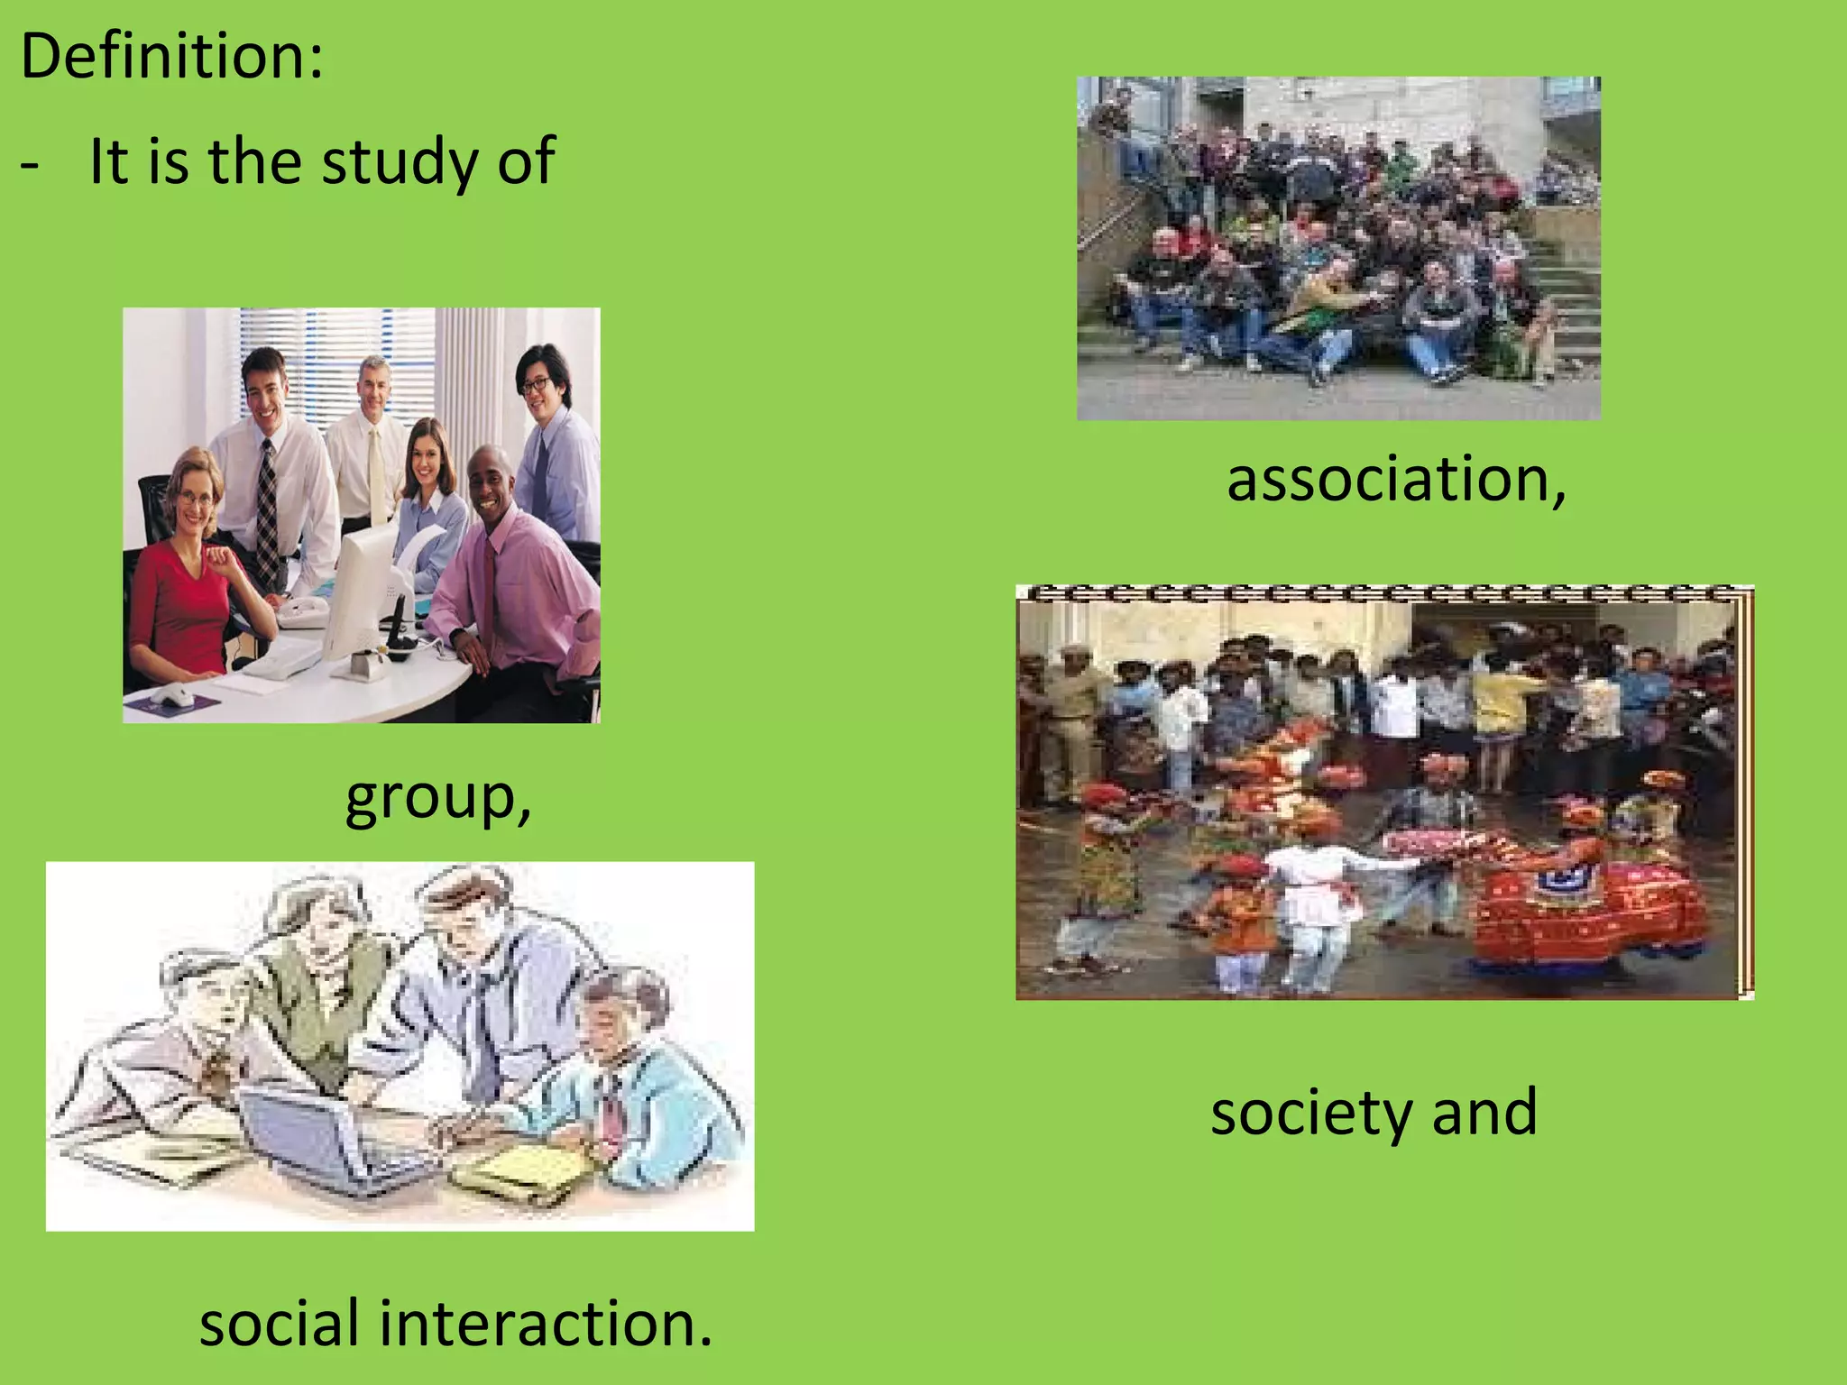

Slide 5
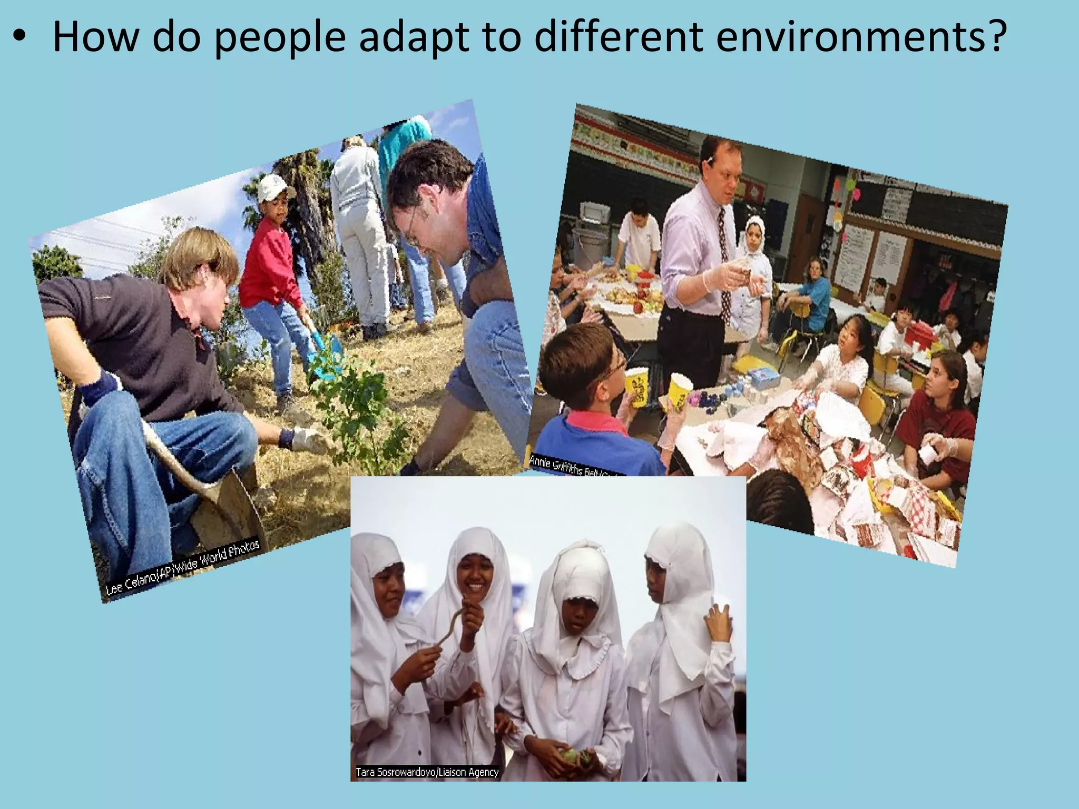

Slide 6
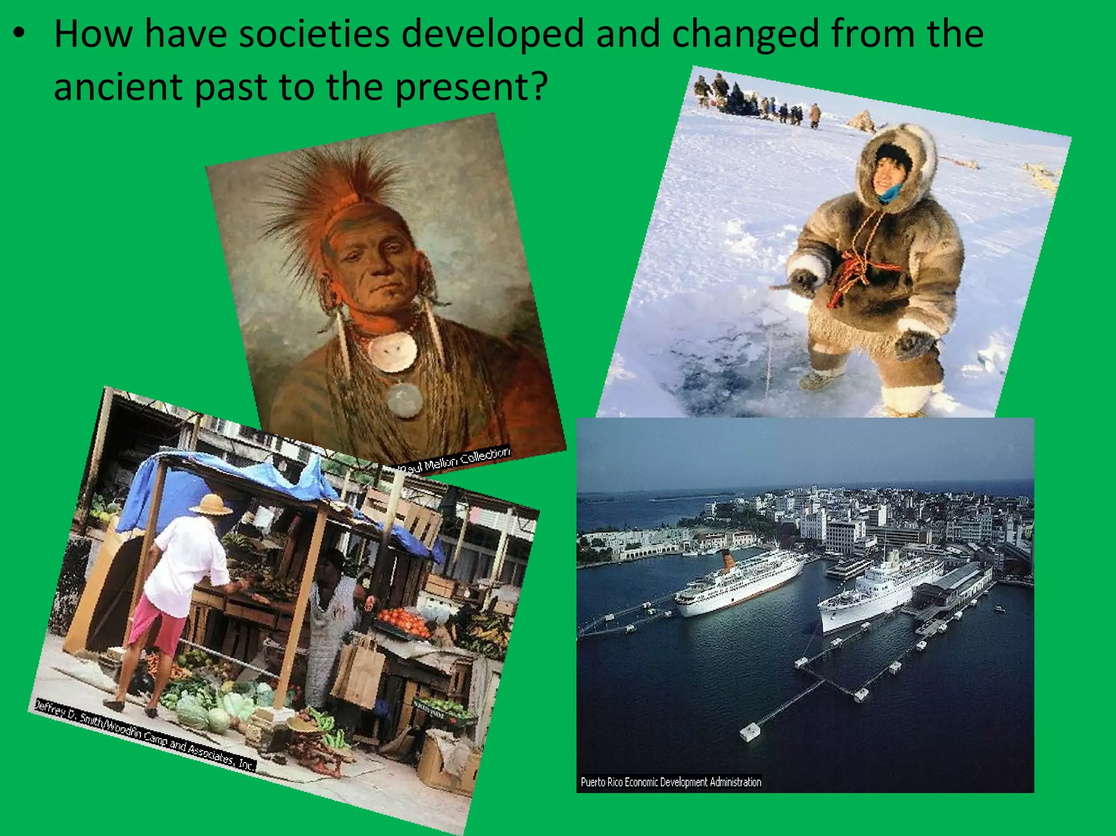

Slide 7
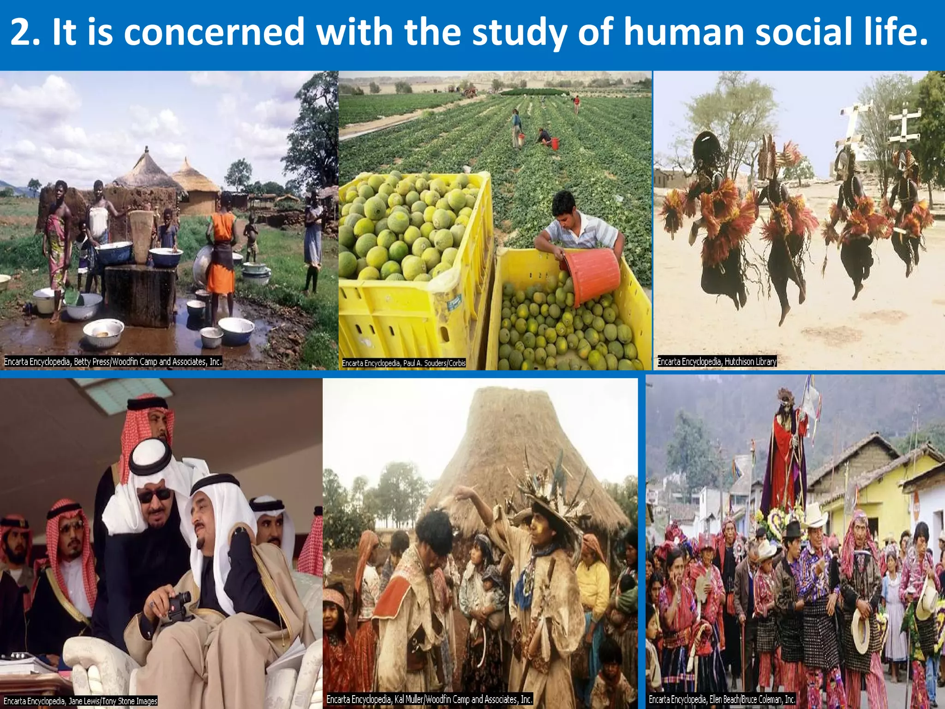

Slide 8
SYLLABUS
(Program) SOCIOLOGY B.A.I
(Course) PAPER I
Introduction to Sociology
PAPER CODE SO- 105
MAX MARKS 75
UNIT I Sociology meaning, scope, subject matter and significance
Basic Concepts Society, community, Association, institution, group, status and role.
UNIT II Social Institutions, family, marriage, kinship, culture and society, socialization, individual and society, social control, social sanctions and norms.
UNIT III Social stratification , its meaning, forms and theories and social mobility its meaning , forms and theories.
UNIT IV Social change meaning, forms and factors, evolution and progress.
UNIT V Social system and process, Social system meaning, elements, characteristics and types and Social process meaning, elements, characteristics and types

Slide 9
SYLLABUS
(Program) SOCIOLOGY B.A.I
(Course) PAPER II
Contemporary Indian Society
PAPER CODE OS- 106
MAX MARKS 75
UNIT I Classical views about Indian Society, Varna, Ashram, Karma, Dharma and Purusharth.
UNIT II Structure of Indian Society, Village, City, Rural urban linkages, Tribes, Dalits, women and Minorities.
UNIT III Basic institutions of Indian Society Caste system, Joint family, marriage and its changing dimensions.
UNIT IV Family Problems Dowry system, Domestic violence, Divorce, Inter- generational and intra-generational conflict, Problems of elderly persons.
UNIT V Folk culture of Chhattisgarh Practices(Pratha), Traditions, food and festivals.

Slide 10
Program outcomes
Sociology learning provides initial knowledge about society, social life and social interactions.
A general Arts Graduate student of Sociology should able to develop:
Critical Thinking: The programme seeks to develop in students the sociological knowledge and skills that will enable them to think critically about society and social issues.
Sociological Understanding: The ability to demonstrate sociological understandings of how individual biographies are shaped by social structures, social institutions, cultural practices, and multiple axes of difference and inequality.
Written and Oral Communication: The ability to Develop communication skills and Social interaction power.

Slide 11
Observation power: a sensible observation power is necessary to identify the research problems in field study. So a perception about human society slowly grows up.
Ethical and Social Responsibility: Students have to learn about institutions, folkways, mores, culture, social control, social inequality, population composition, population policy, society and culture of India. All these help to communicate among the students of sociology a sense of ethical and social responsibility.
Professional and Career Opportunities: Students will have the opportunity to join professional careers in Sociology and allied fields. Sociology provides an intellectual background for students considering careers in business, social services, public policy, government service, nongovernmental organizations (NGOs), foundations, or academia. This programme lays foundation for further study in Sociology, Social work, Women Studies, Rural Development, Social Welfare and in other allied subjects.

Slide 12
COURSE OUTCOME
COURSE, PAPER -I
INTRODUCTION TO SOCIOLOGY
The course is intended to introduce the students to a sociological way of thinking. It provides an understanding of the discipline of Sociology and sociological perspective. It also provides foundation for other more detailed and specialized courses in sociology. The students will be able to: -
Define Sociology and demonstrate nature, scope and subject-matter of Sociology.
- Demonstrate how Sociology differ from and similar to other social sciences and their areas of interdependence.
- Acquaint themselves with the basic concepts of Sociology like Society, community, institutions, Association, Group, Social Structure and function, Status and role
- Know the basic Social progresses: cooperation, competition, conflict, accommodation, assimilation
- Learn themselves with the basic Social institutions: Marriage, family, kinship, religion, social stratification
- Understand the individual and society: Society, culture and socialization, relation between Individual and society, social control, norms, values, and sanctions etc.

Slide 13
COURSE OUTCOME
COURSE, PAPER II
CONTEMPORARY INDIAN SOCIETY
The aim of this course is to make the students learn about basic institutions of Indian society and also will be able to: -
Learn about classical views of traditional Indian society like Varna. Ashram vyavastha, Karma and Purusharth.
Learn about the structure of Indian society, village and town, rural-urban linkages etc.
Explores substantive basic institutions of Indian society like Family, Kinship, Marriage-Hindu, Muslim, Christian and changing dimension
- Define and demonstrate Social problems in India Poverty, Dowry, Bonded Labour, illiteracy, Child abuse, Youth unrest, drug abuse, and problems of elderly people.
- Learn more about cultural aspects of Chhattisgarh state like Sanctions and values, festivals, folk dance and songs, rituals and food specialties etc. of the state.

Slide 14
Examination System
Annual Examination system followed.
Six Unit Tests are compulsory for every student during the session.
Internal Assessment is of 15 marks which is based on overall performance of student including attendance, unit tests score, participation in departmental activities and score in pre-university examination.
Pre-university examination is conducted by an institution before final exams.

Slide 15


Slide 16
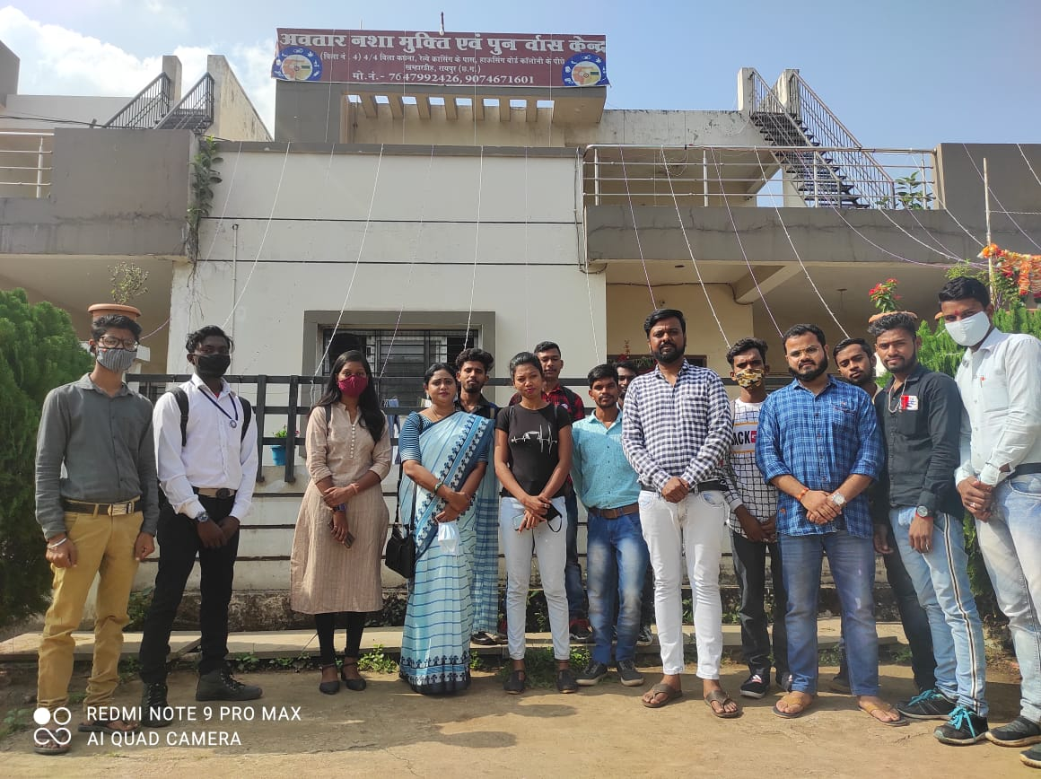
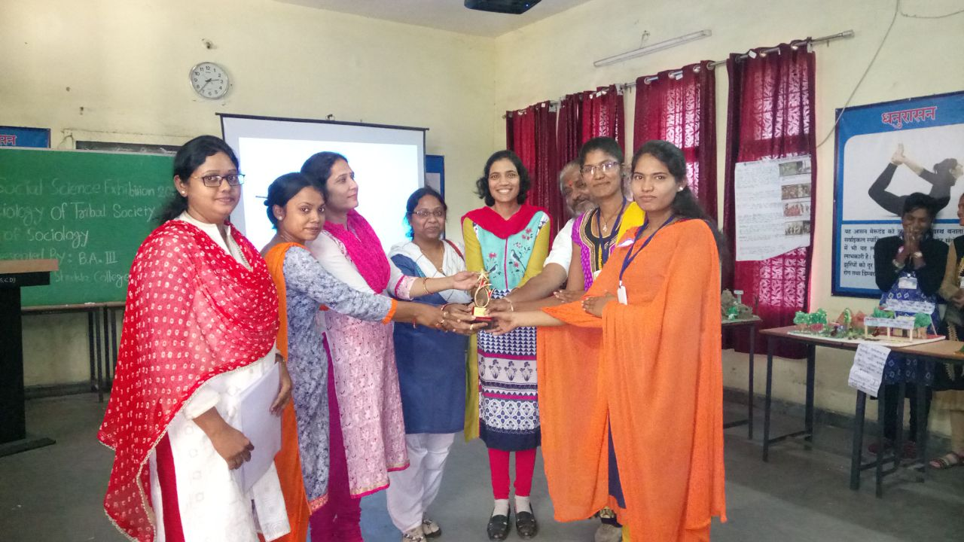
Field Visit organized by the department of sociology and prize distribution

Slide 17
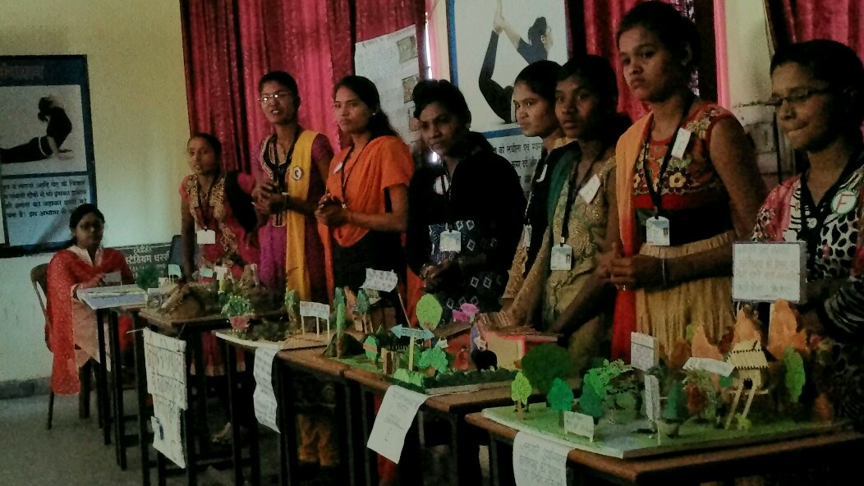
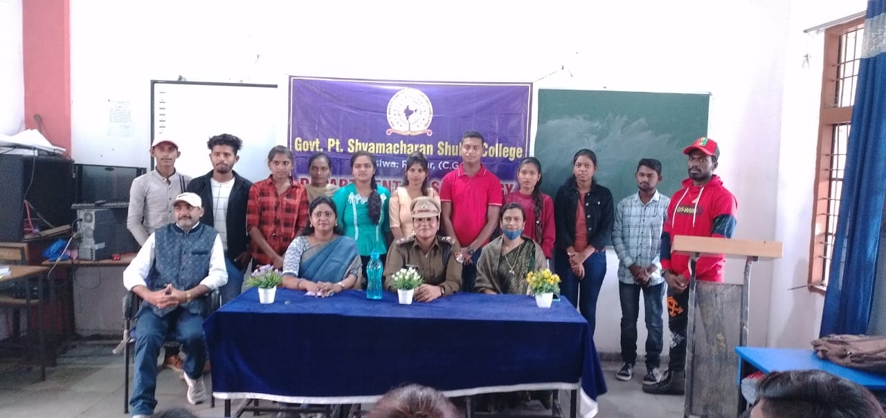
Model Making Competition and Invited Talk of Police Officer organized by department of Sociology

Slide 18
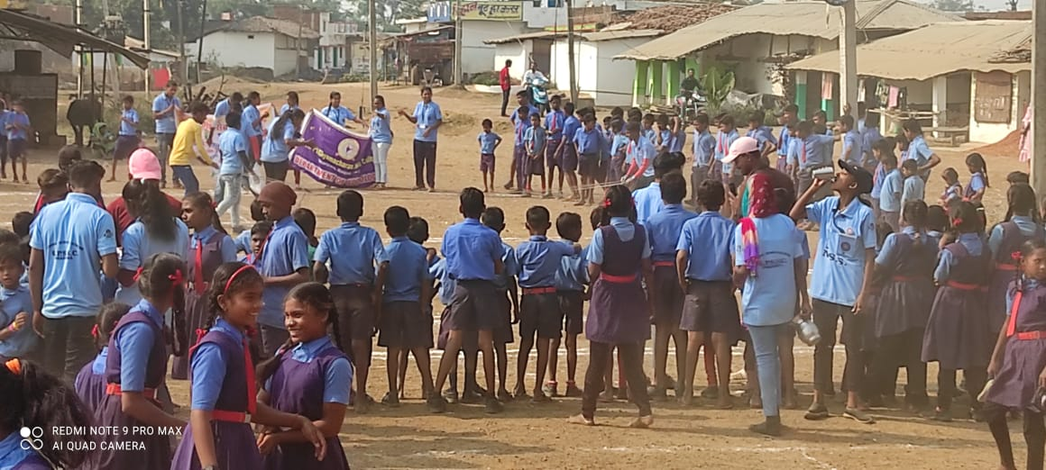
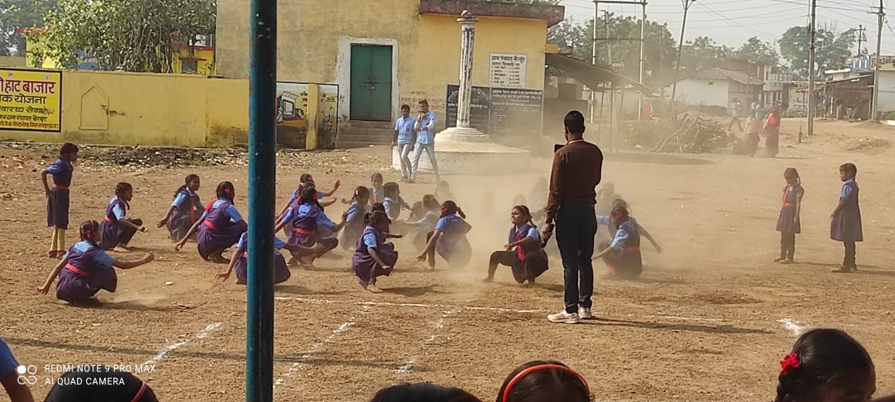
Extension Activity by Department of Sociology

Slide 19
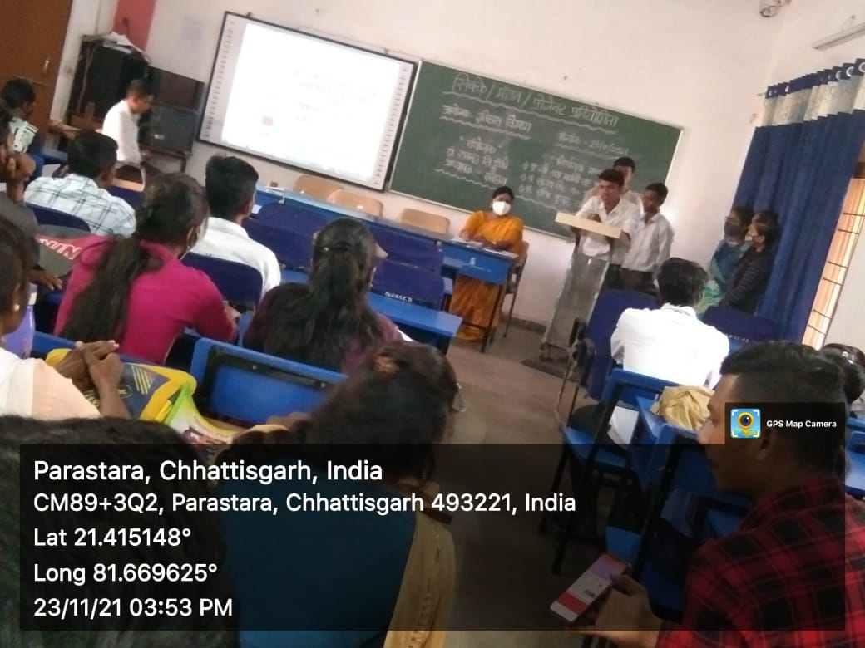
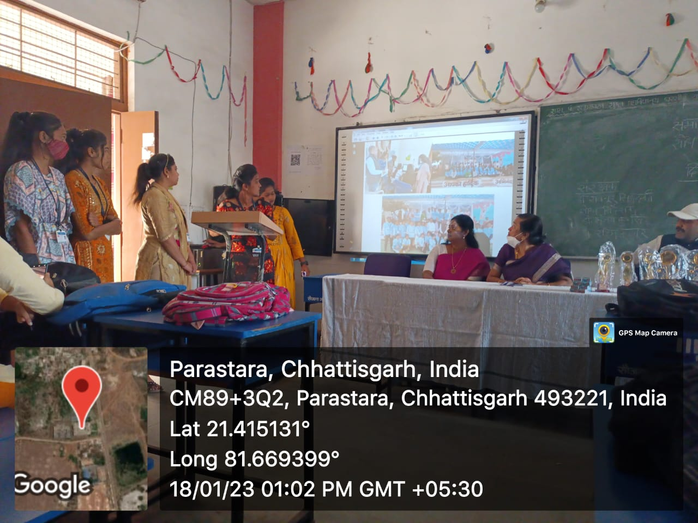
SEMINAR PRESENTATION BY STUDENTS OF SOCIOLOGY

Slide 20
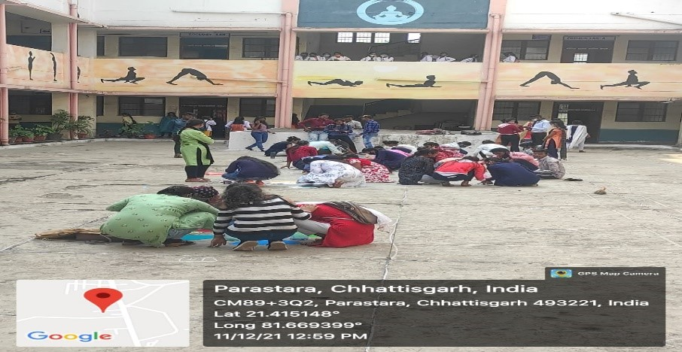
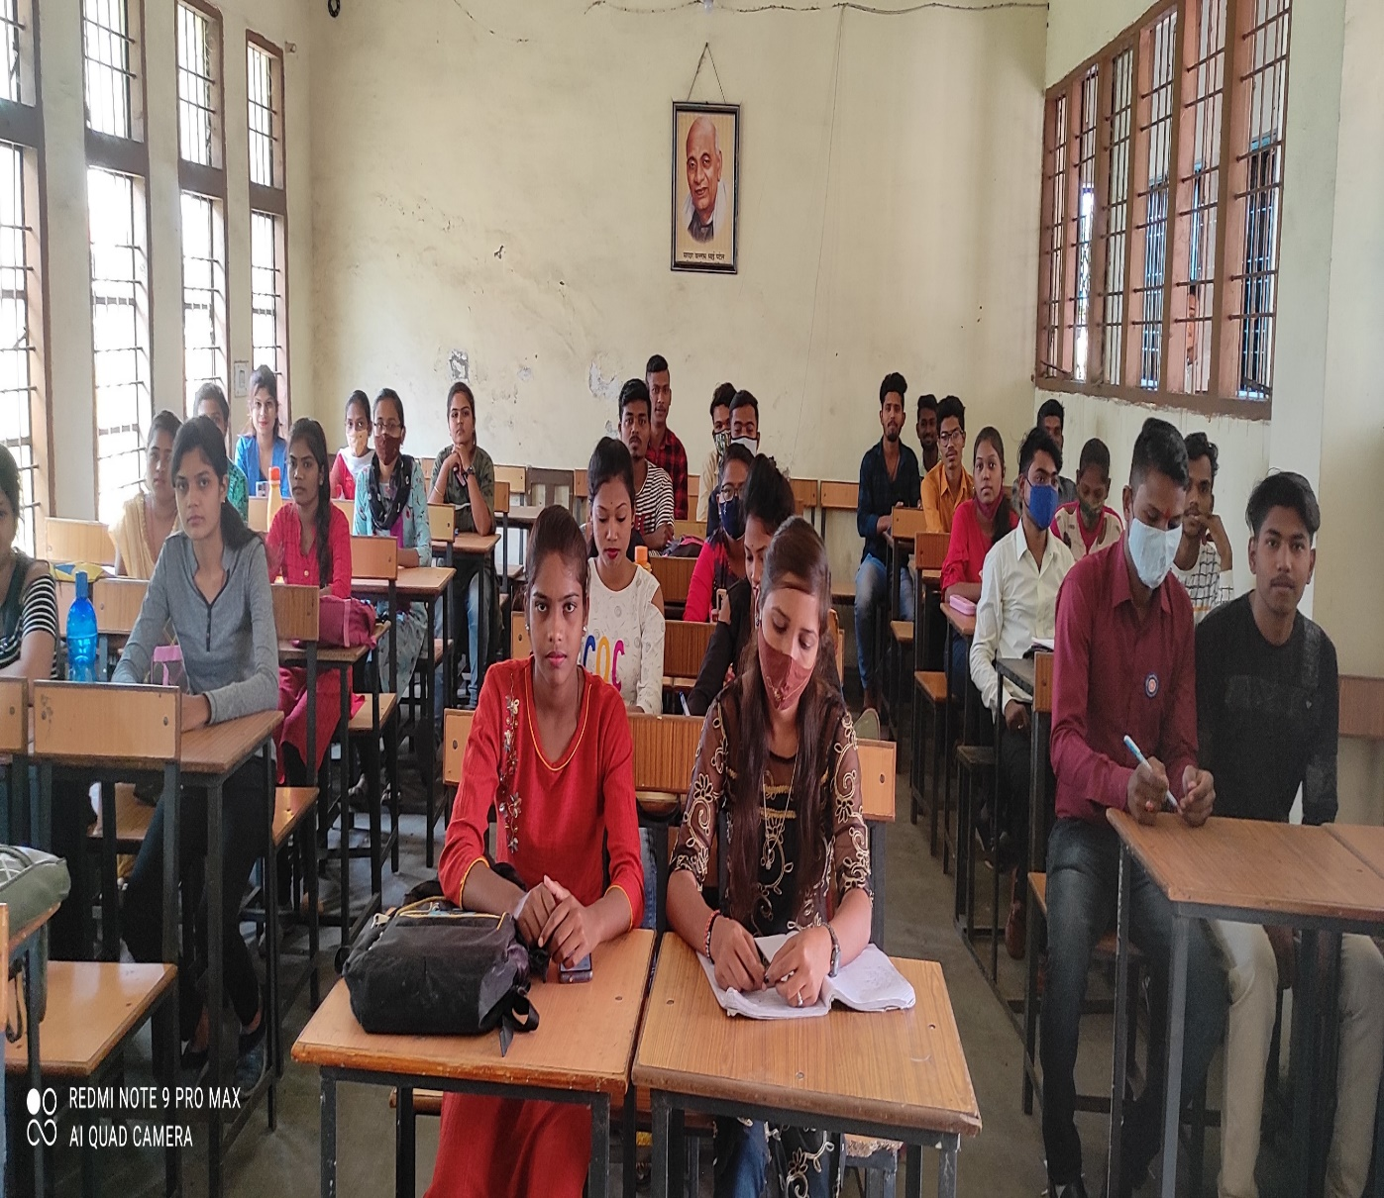
Various Competitions organized by the department of Sociology

Slide 21
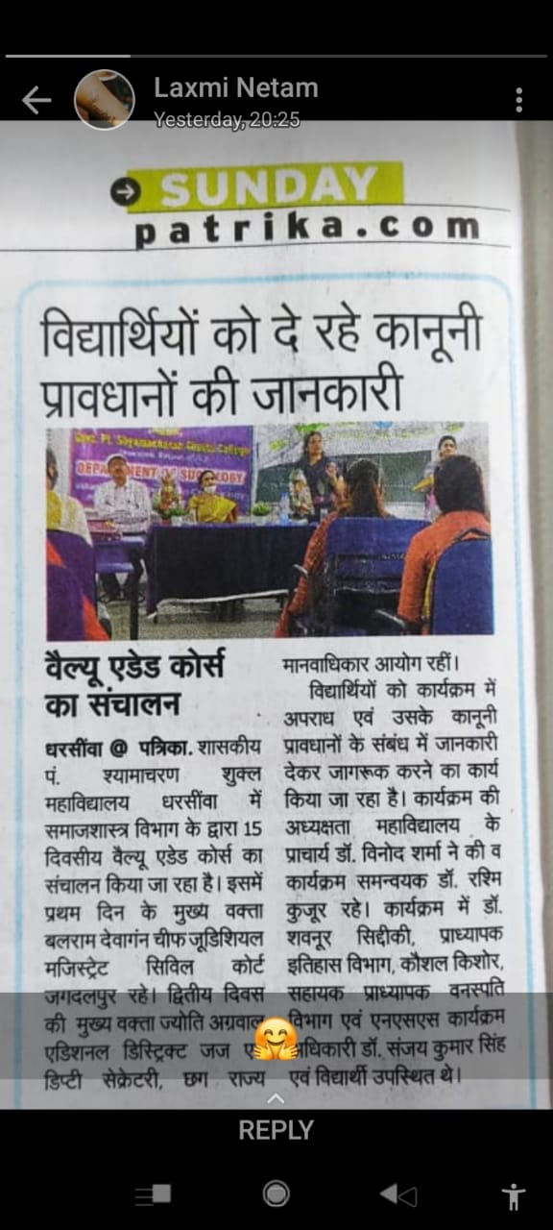
30 Hours Value added Course organized by department of Sociology

Slide 22
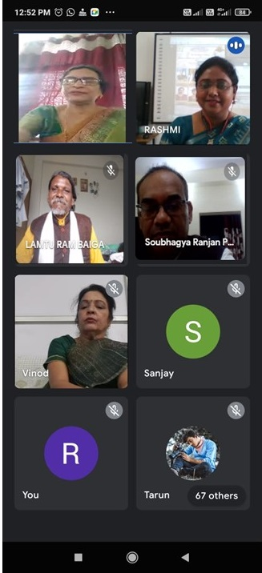

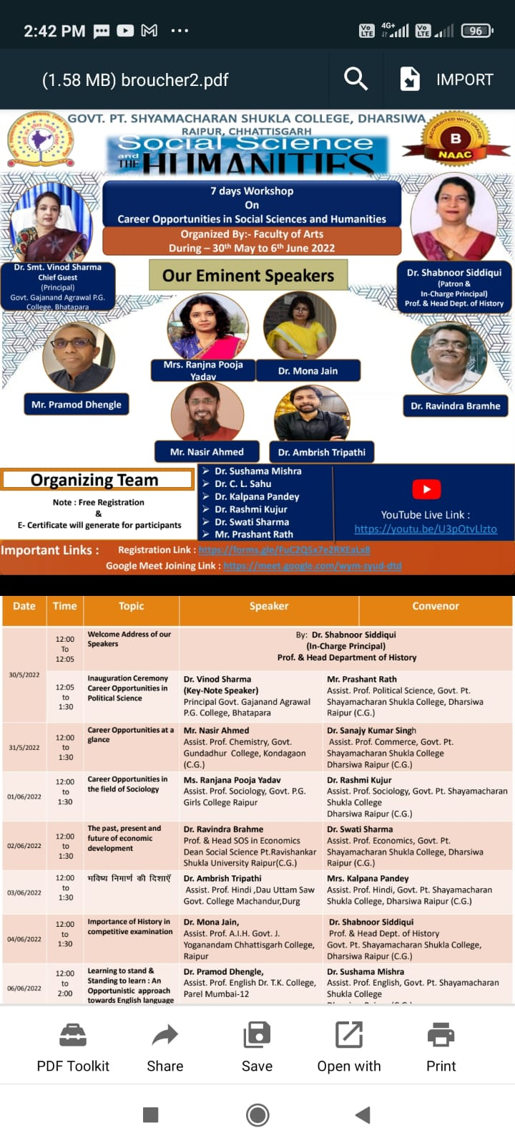
07 Days Workshop on Carrier Guidance and National Webinar Organized by the department of Sociology

Slide 23
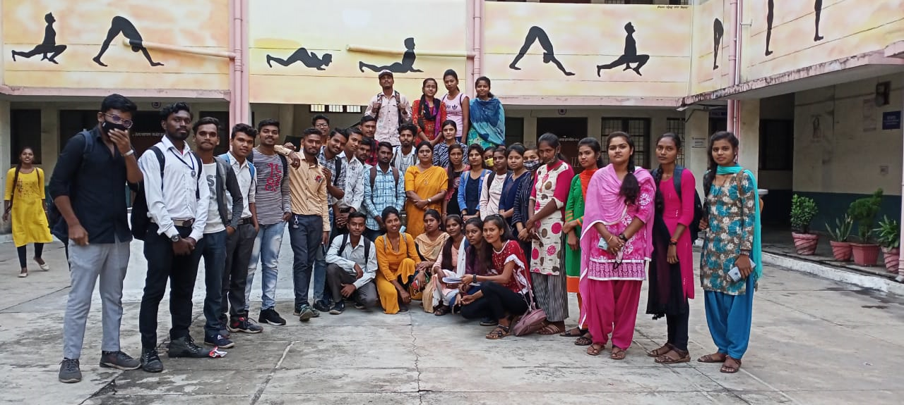
T
H
A
N
K
S

